Slide 1
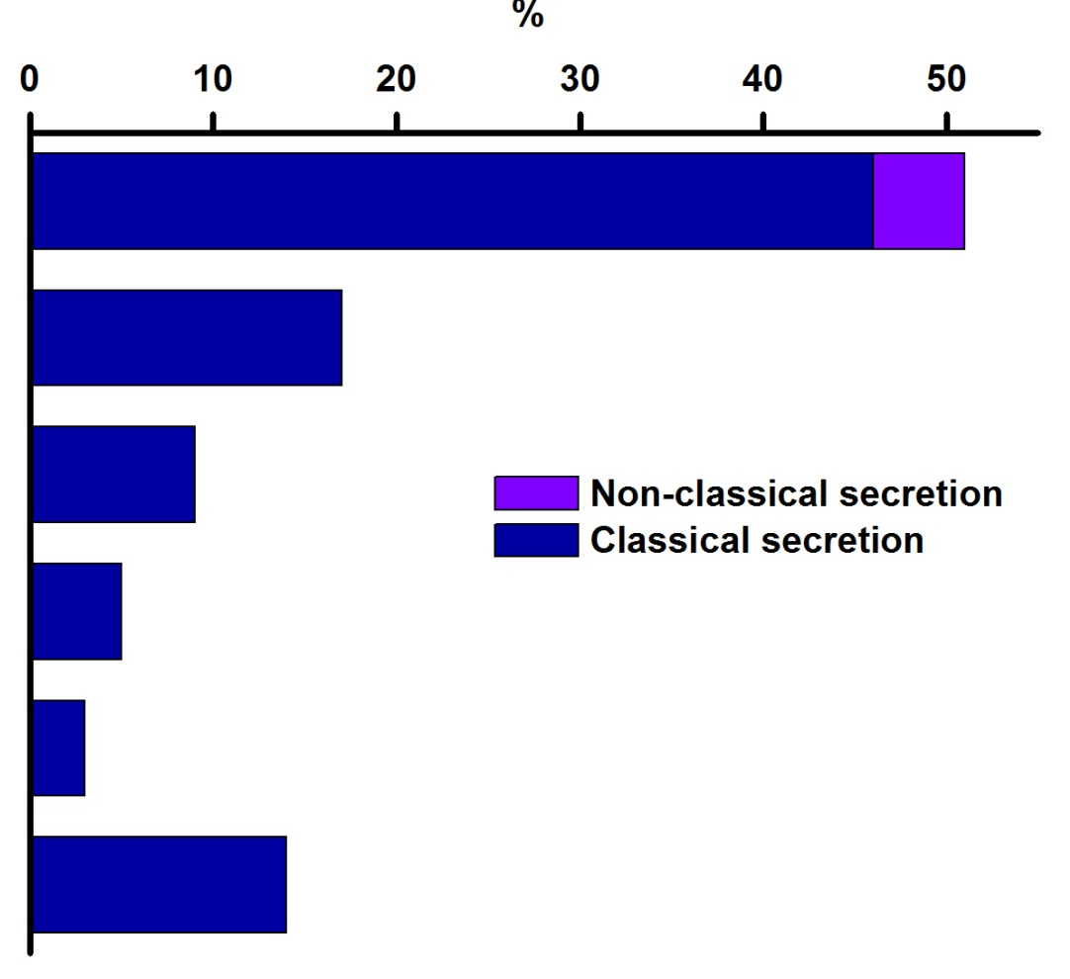
N-glycoprotein (subcellular location)
Secretory pathway
Cytoplasm
Chloroplast
Mitochondria
Nucleus
Others
Computational prediction of the subcellular location of the N-gycoproteins isolated from green mature tomato fruit with concavaline A column. Signal P, Target P1.1, subcell specialization 2.5 and SecretomeP 2.0 were use for the analysis.

